Slide 1

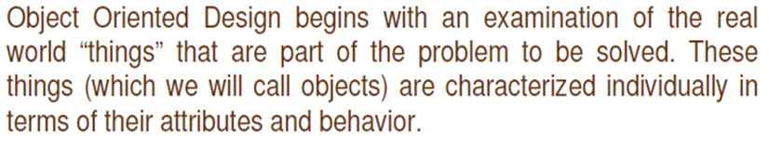
Object Oriented Design
Object oriented design is the result of focusing attention not on the function performed by the program, but instead on the data that are to do manipulated by the program.
It is mainly the process of using an object methodology to design a computing system or application.

Slide 2
Basic Concepts of OOD
Object Oriented Design is not dependent on any specific implementation language. Problems are modeled using objects.
Objects have
Behaviour (they do things)
State (which changes when they do things)

Slide 3
Terminologies related to OOD
Object
The word “Object” is used very frequently and conveys different meaning in different circumstances. Here, meaning is an entity able to save a state (information) and which offers a number of operations (behavior) to either examine or affect this state. An object is characterized by number of operations and a state which remembers the effect of these operations
.

Slide 4
Messages
Objects communicate by message passing. Messages consist of the identity of the target object, the name of the requested operation and any other operation needed to perform the function. Message are often implemented as procedure or function calls.

Slide 5
Abstraction
In object oriented design, complexity is managed using abstraction. Abstraction is the elimination of the irrelevant and the amplification of the essentials.

Slide 6
Class
In any system, there shall be number of objects. Some of the objects may have common characteristics and we can group the objects according to these characteristics. This type of grouping is known as a class. Hence, a class is a set of objects that share a common structure and a common behaviour.

Slide 7
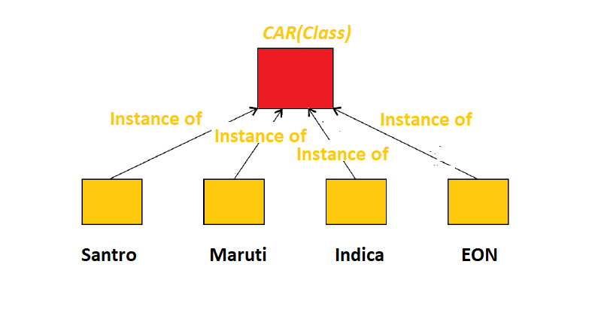
Ex. We may define a class “car” and each object that represent a car becomes an instance of this class. In this class “car”, Indica, Santro, Maruti, Indigo are instances of this class as shown in fig

Slide 8
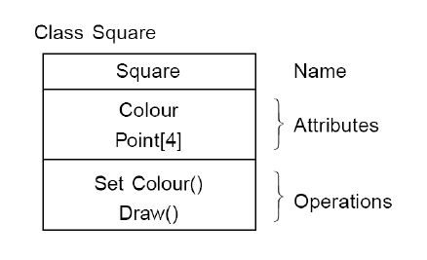
Attributes
An attributes is a data value held by the objects in a class. The square class has two attributes: a colour and array of points. Each attributes has a value for each object instance

Slide 9
Operations
An operation is a function or transformation that may be applied to or by objects in a class.
In the square class, we have two operations: set colour() and draw(). All objects in a class share the same operations. An object “knows” its class, and hence the right implementation of the operation.

Slide 10
Inheritance
OOD allows similar classes to stack up in a hierarchical manner where the lower or sub-classes can import, implement, and re-use allowed variables and functions from their immediate super classes. This property of OOD is called an inheritance. This makes it easier to define a specific class and to create generalized classes from specific ones.

Slide 11
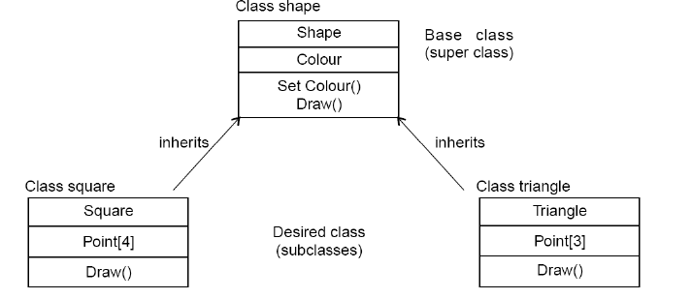
Source: Software Engineering by KK Agarwal &Yogesh Singh

Slide 12
Polymorphism
OOD languages provide a mechanism where methods performing similar tasks but vary in arguments, can be assigned the same name. This is known as polymorphism, which allows a single interface is performing functions for different types.

Slide 13
Encapsulation (Information Hiding)
Encapsulation is also commonly referred to as “Information Hiding”. It consists of the separation of the external aspects of an object from the internal implementation details of the object.

Slide 14
Hierarchy
Hierarchy involves organizing something according to some particular order or rank. It is another mechanism for reducing the complexity of software by being able to treat and express sub-types in a generic way.

Slide 15
Steps for analysis & design of object oriented system
Problem Statement
Create Use Case Model
Draw Activity diagram(if required)
Draw the interaction diagrams
Draw the class diagrams
Draw the state chart, object diagram(if required)
Draw component and deployment diagram
Design document

Slide 16
Create use case model
First step is to identify the actors interacting with the system. We should then write the use case and draw the use case diagram.

Slide 17
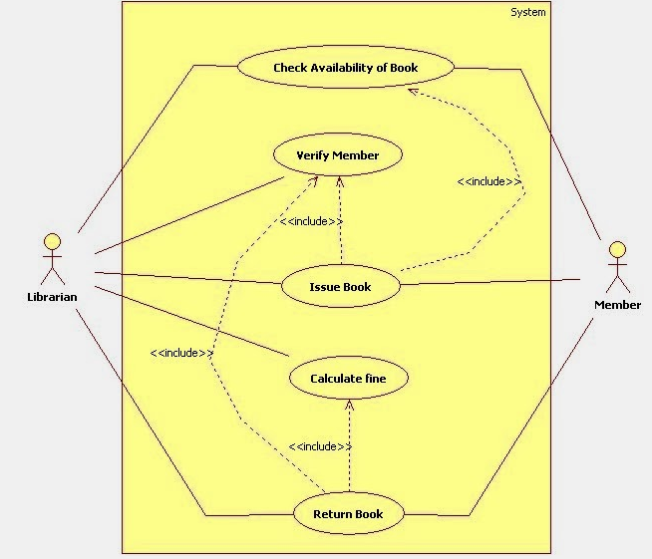
Use Case Diagram of Library Management System

Slide 18
Draw activity diagram (If required)
Activity Diagram illustrate the dynamic nature of a system by modeling the flow of control form activity to activity. An activity represents an operation on some class in the system that results in a change in the state of the system.

Slide 19
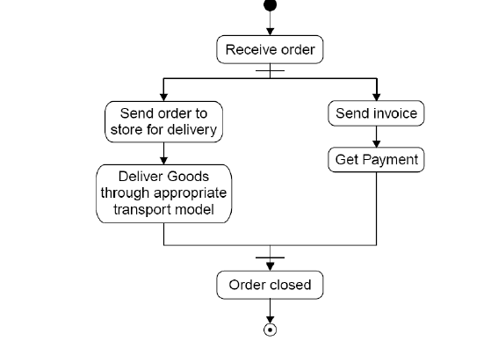
Activity diagram processing an order to deliver some goods.
Source: Software Engineering by KK Agarwal &Yogesh Singh

Slide 20
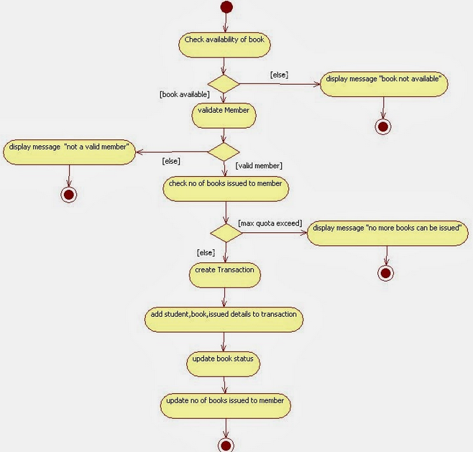
Activity Diagram of Library Management System

Slide 21
Draw the interaction diagram
An interaction diagram shows an interaction, consisting of a set of objects and their relationship, including the messages that may be dispatched among them. Interaction diagrams address the dynamic view of a system
Steps to draws interaction diagrams are as under
a)Firstly, we should identify that the objects with respects to every
use case.
b) We draw the sequence diagrams for every use case.
d) We draw the collaboration diagrams for every use case.

Slide 22
The object types used in this analysis model are entity objects, interface objects and control objects
ENTITY OBJECT INTERFACE OBJECT CONTROL OBJECT

Slide 23
Sequence Diagram
Sequence diagram descries interaction among classes in terms of an exchange of message over time. Sequence diagram demonstrate the behavior of objects in a use case by describing the object and messages they pass. A sequence diagram depicts the sequence of actions that occurs in system. The invocation of methods in each object and the order in which they captured in a sequence diagram. This makes sequence diagram very useful.

Slide 24
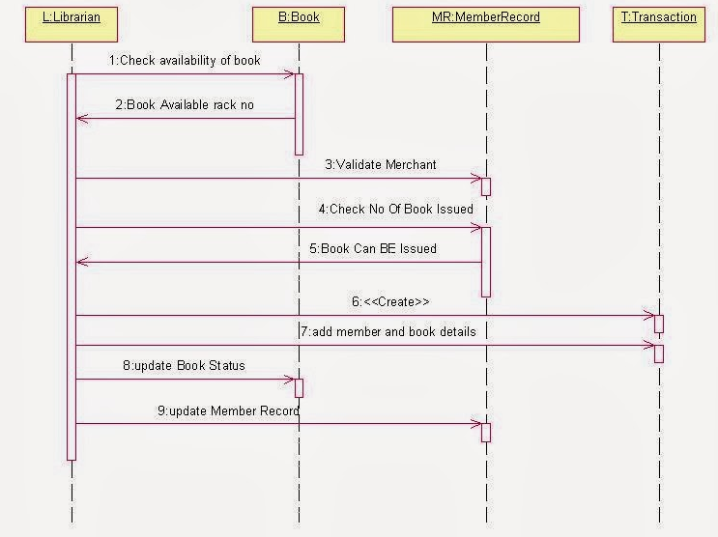
Sequence Diagram of Library Management System

Slide 25
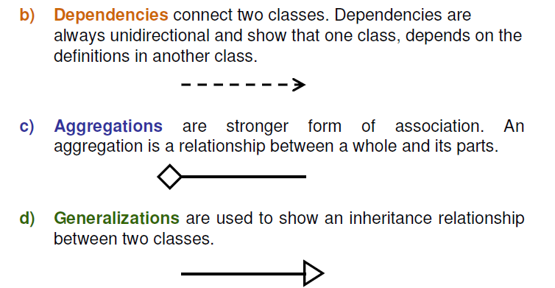
Draw the class diagram
The class diagram shows the relationship amongst classes. There are
four types of relationships in class diagrams.
a) Association are semantic connection between classes. When an association connects two classes, each class can send messages to the other in a sequence or a collaboration
diagram. Associations can be bi-directional or unidirectional.

Slide 26
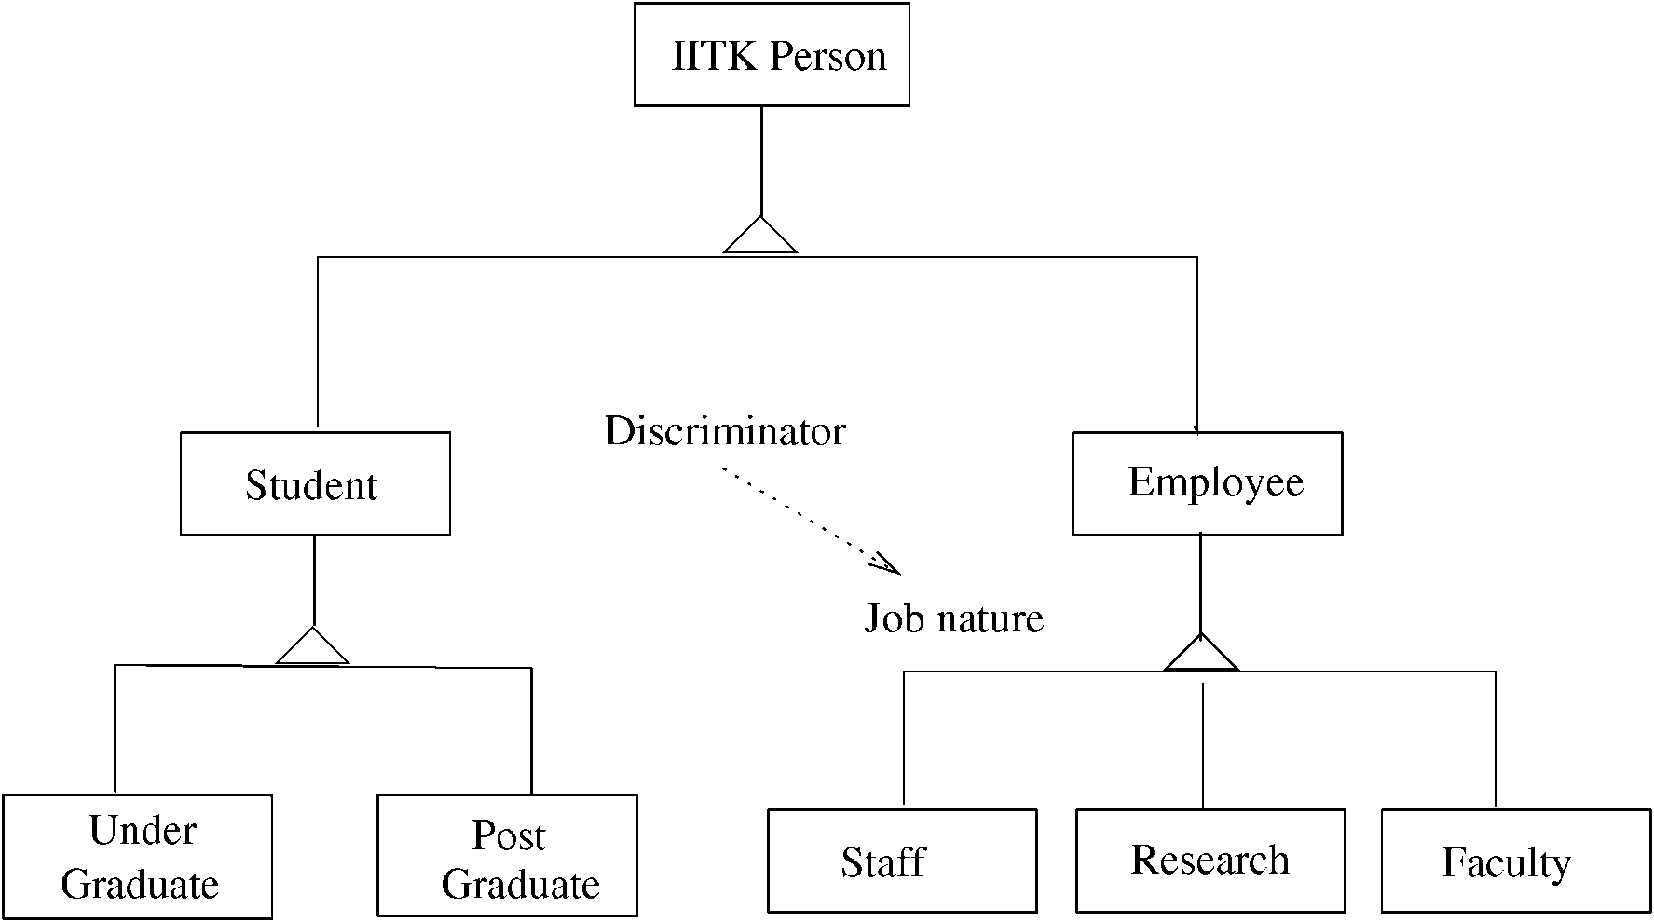
Example – class hierarchy

Slide 27
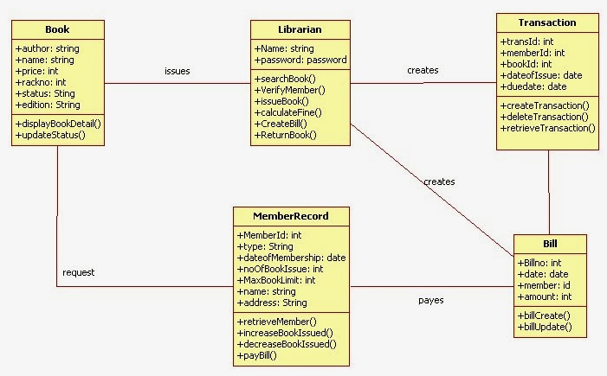
Class Diagram of Library Management System

Slide 28
Design of state chart diagrams
A state chart diagram is used to show the state space of a given class, the event that cause a transition from one state to another, and the action that result from a state change. A state transition diagram for a “book” in the library system is given

Slide 29
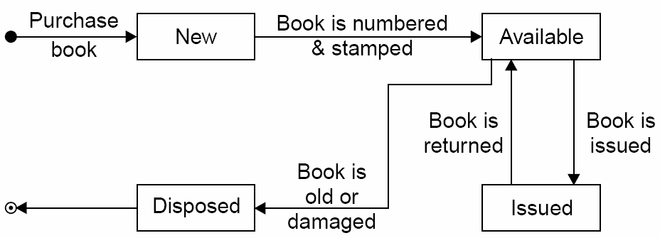
Source: Software Engineering by KK Agarwal &Yogesh Singh

Slide 30
Draw component and development diagram
Component diagrams address the static implementation view of a system they are related to class diagrams in that a component typically maps to one or more classes, interfaces or collaboration.

Slide 31
Unified Modeling Language (UML)
Unified Modeling Language (UML) is a general purpose modeling language. The main aim of UML is to define a standard way to visualize the way a system has been designed. It is quite similar to blueprints used in other fields of engineering.

Slide 32
Unified Modeling Language (UML) and Modeling
UML is a graphical notation useful for OO analysis and design
Allows representing various aspects of the system
Various notations are used to build different models for the system
OOD methodologies use UML to represent the models they create

Slide 33
Modeling
Modeling is used in many disciplines – architecture, aircraft building, …
A model is a simplification of reality
A good model includes those statements that have broad effect and omits minor statements
A model of a system is not the system!

Slide 34
Why build models?
Models help us visualize a system
Help specify the system structure
Gives us a template that can guide the construction
Document the decisions taken and their rationale

Slide 35
Views in an UML
A use case view
A design view
A process view
Implementation view
Deployment view
We will focus primarily on models for design – class diagram, interaction diagram, etc.

Slide 36
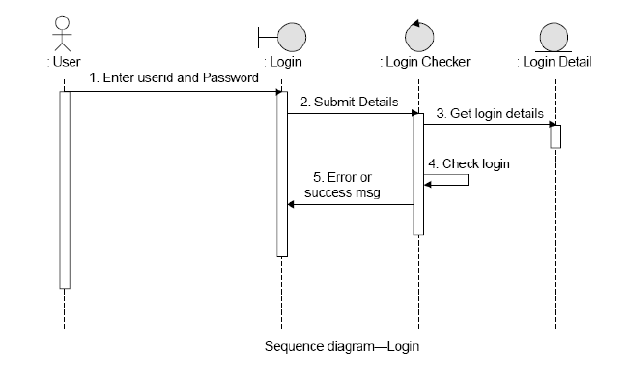
Source: Software Engineering by KK Agarwal &Yogesh Singh

Slide 37
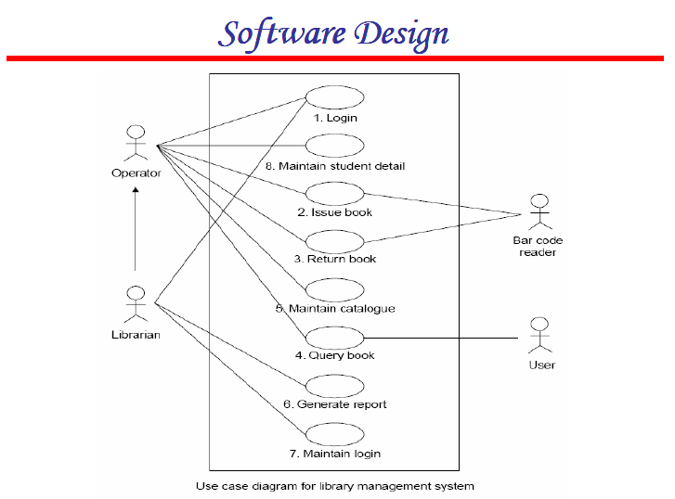

Slide 38
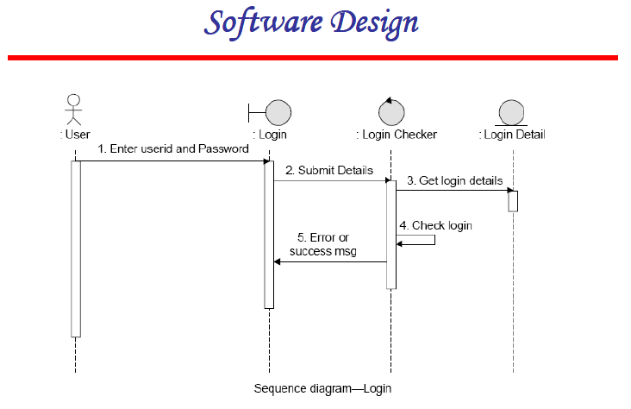

Slide 39
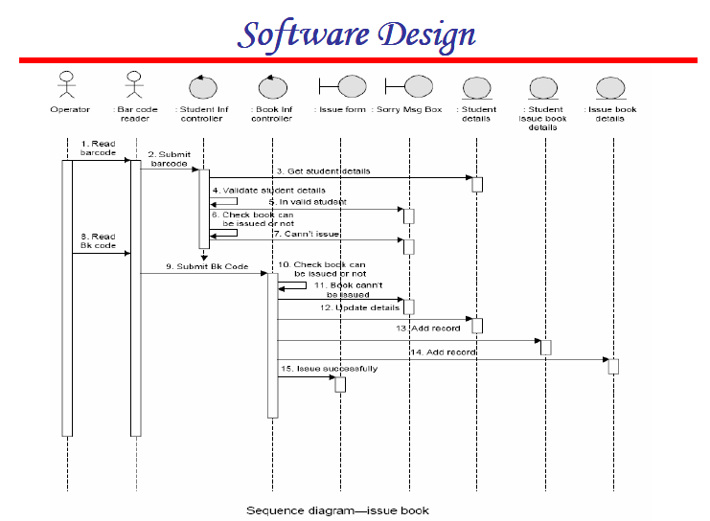

Slide 40
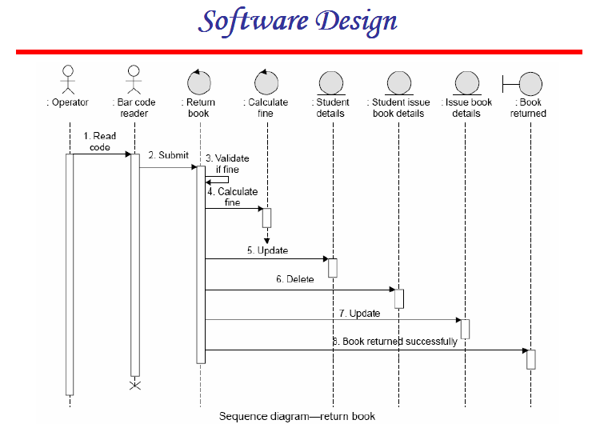

Slide 41
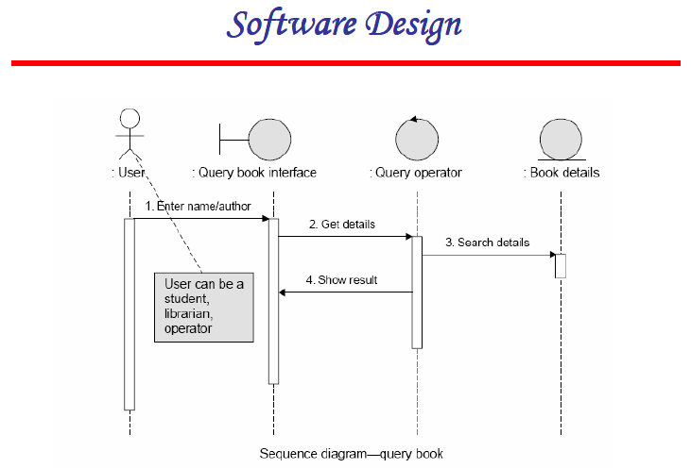

Slide 42
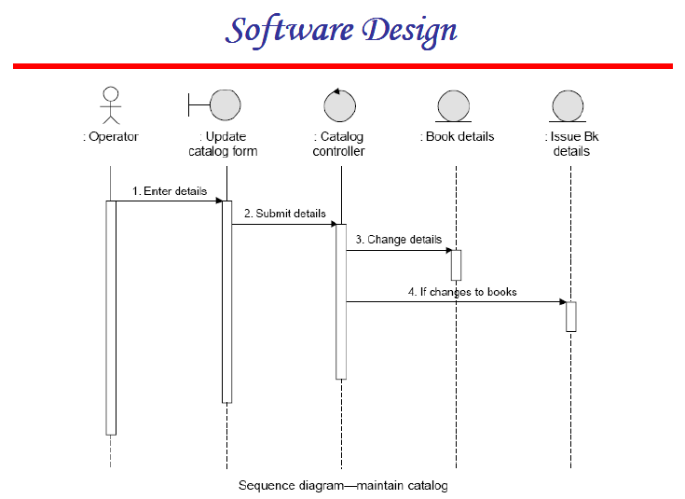

Slide 43
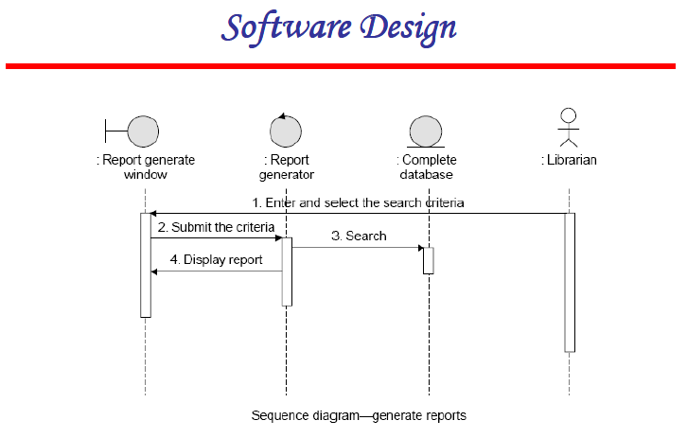

Slide 44
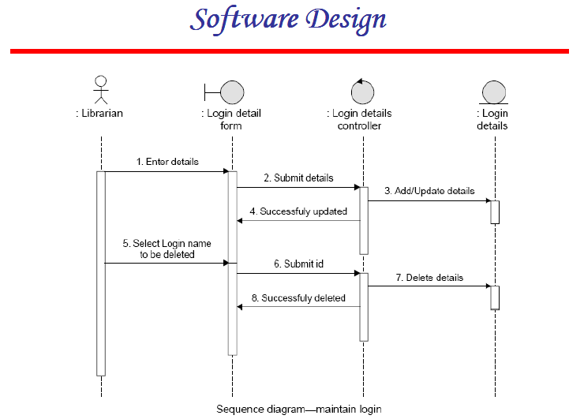

Slide 45
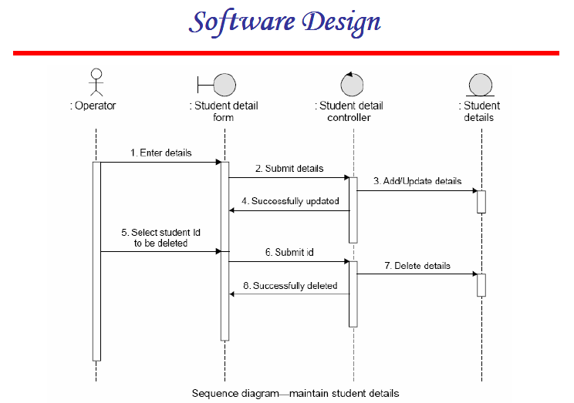

Slide 46
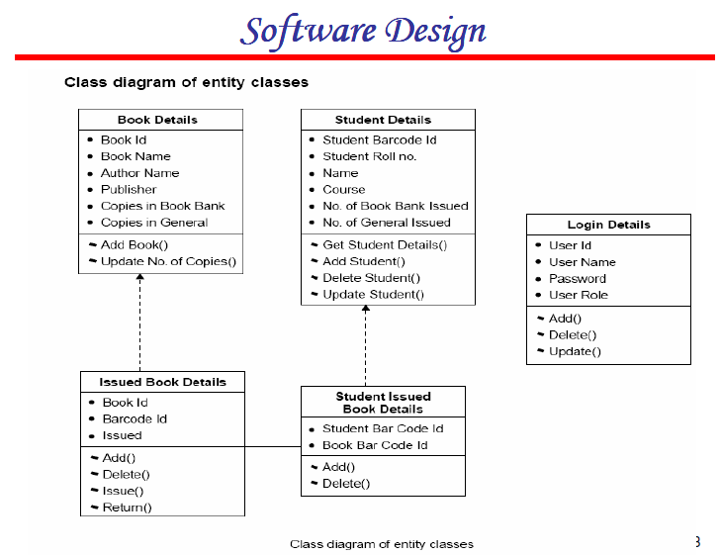

Slide 47
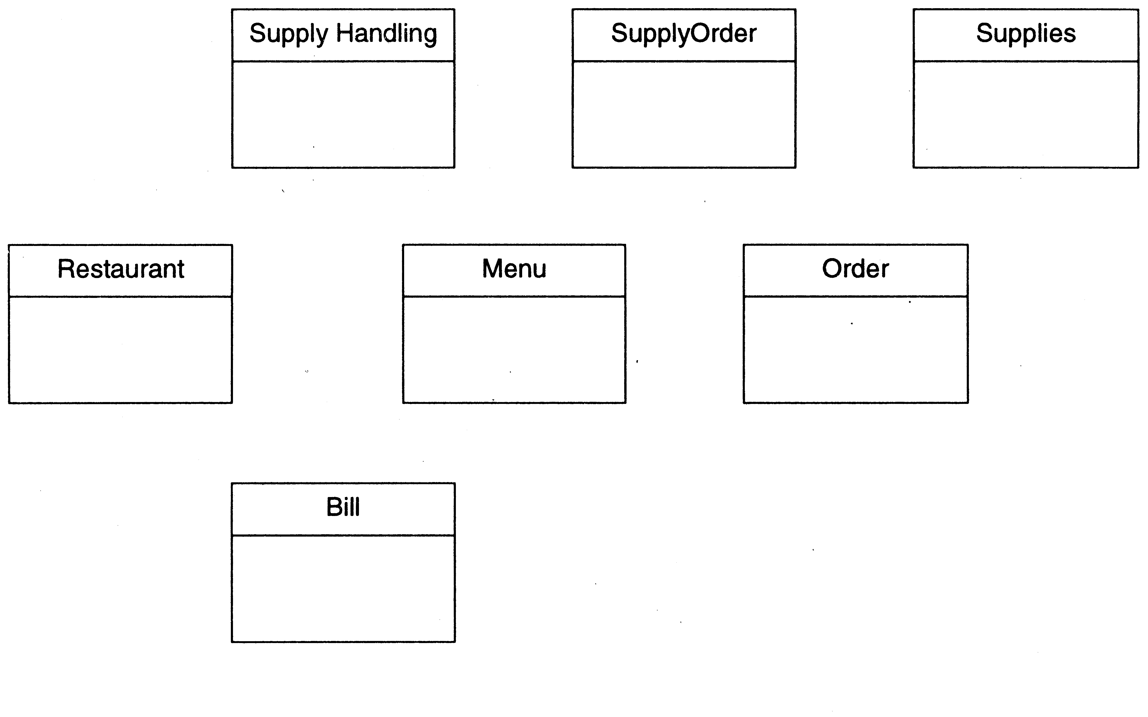
Restaurant example: Initial classes

Slide 48
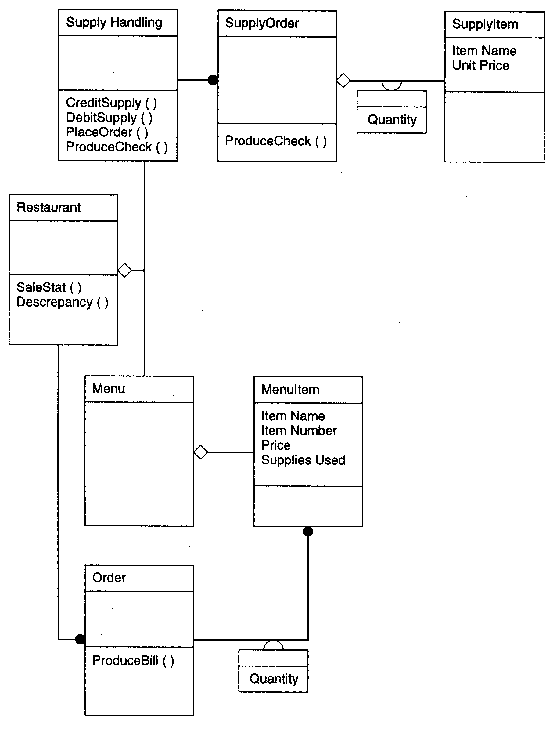

Slide 49
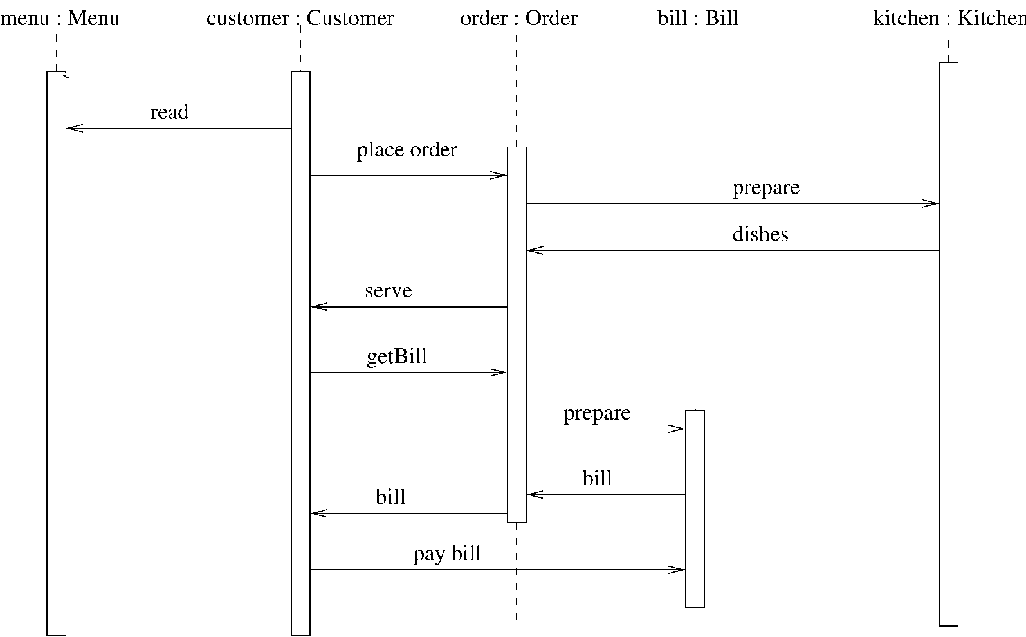
Restaurant example: a seq diag

Slide 50
Coding
The coding is the process of transforming the design of a system into a computer language format. This coding phase of software development is concerned with software translating design specification into the source code. It is necessary to write source code & internal documentation so that conformance of the code to its specification can be easily verified.
Coding is done by the coder or programmers who are independent people than the designer. The goal is not to reduce the effort and cost of the coding phase, but to cut to the cost of a later stage. The cost of testing and maintenance can be significantly reduced with efficient coding.
Source: https://www.javatpoint.com/

Slide 51
Goals of Coding
To translate the design of system into a computer language format: The coding is the process of transforming the design of a system into a computer language format, which can be executed by a computer and that perform tasks as specified by the design of operation during the design phase.
To reduce the cost of later phases: The cost of testing and maintenance can be significantly reduced with efficient coding.
Making the program more readable: Program should be easy to read and understand. It increases code understanding having readability and understandability as a clear objective of the coding activity can itself help in producing more maintainable software.
Source: https://www.javatpoint.com/

Slide 52
Verification
It is the process of evaluating a system or component to determine whether the products of a given development phase satisfy the conditions imposed at the start of that phase.
Validation
It is the process of evaluating a system or component during or at the end of development process to determine whether it satisfies the specified requirements .
Testing= Verification +Validation

Slide 53
Code Inspection
Code Inspection is the most formal type of review, which is a kind of static testing to avoid the defect multiplication at a later stage.
The main purpose of code inspection is to find defects and it can also spot any process improvement if any.
An inspection report lists the findings, which include metrics that can be used to aid improvements to the process as well as correcting defects in the document under review.
Preparation before the meeting is essential, which includes reading of any source documents to ensure consistency.
Inspections are often led by a trained moderator, who is not the author of the code.
The inspection process is the most formal type of review based on rules and checklists and makes use of entry and exit criteria.
It usually involves peer examination of the code and each one has a defined set of roles.
After the meeting, a formal follow-up process is used to ensure that corrective action is completed in a timely manner.
Source: https://www.tutorialspoint.com/

Slide 54
Metrics
A metric is a quantitative measure of the degree to which a system, component or process possesses a given attribute.

Slide 55
Use of Software Metrics
1.How to measure the size of a software?
2. How much will it cost to develop a software?
3. How many bugs can we expect?
4. When can we stop testing?
5. When can we release the software?
6. What is the complexity of a module?
7. What is the module strength and coupling?
8. What is the reliability at the time of release?
9. Which test technique is more effective?
10. Are we testing hard or are we testing smart?
11. Do we have a strong program or a week test suite?

Slide 56
Different Definitions of Metrics
Pressman explained as “A measure provides a quantitative indication of the extent, amount, dimension, capacity, or size of some attribute of the product or process”.
Fenton defined measurement as “ it is the process by which numbers or symbols are assigned to attributes of entities in the real world in such a way as to describe them according to clearly defined rules”.

Slide 57
Software Metrics
Software metrics can be defined as “The continuous application of measurement based techniques to the software development process and its products to supply meaningful and timely management information, together with the use of those techniques to improve that process and its products”.

Slide 58
Categories of Metrics
1:Product metrics: Describe the characteristics of the product such as size, complexity, design features, performance, efficiency, reliability, portability, etc.
2:Process metrics: Describe the effectiveness and quality of the processes that produce the software product.
Examples are:
Effort required in the process
Time to produce the product
Effectiveness of defect removal during development
Number of defects found during testing
Maturity of the process

Slide 59
Continue…
3.Project metrics: Describe the project characteristics and execution.
Examples are :
Number of software developers
Staffing pattern over the life cycle of the software
Cost and schedule
Productivity

Slide 60
Token Count
Halstead Vocabulary
The size of the vocabulary of a program, which consists of the number of unique tokens used to build a program is defined as:
number of unique tokens used to build a program is defined as:
η = η1+ η2
η : vocabulary of a program
η1 : number of unique operators
η2: number of unique operands

Slide 61
Length of the program
Halstead Program Length
The length of the program in the terms of the total number of tokens used is:
N = N1+N2
N : program length
N1 : total occurrences of operators
N2 : total occurrences of operands
Estimated Program Length
N^ = η1 log₂ η1 + η2 log₂ η2

Slide 62
Volume
V = N * log2η
The unit of measurement of volume is the common unit for size “bits”. It is the actual size of a program if a uniform binary encoding for the vocabulary is used.
Potential Volume
V*=(2+η2*) log2 (2+η2*)
unique input and output parameters are represented by η2*
Program Level
L = V* / V
The value of L ranges between zero and one,
with L=1 representing a program written at the highest possible level (i.e., with minimum size).

Slide 63
Program Difficulty
D = 1 / L
As the volume of an implementation of a program increases, the program level decreases and the difficulty increases. Thus, programming practices such as redundant usage of operands, or the failure to use higher-level control constructs will tend to increase the volume as well as the difficulty.
Effort
E = V / L = D * V
The unit of measurement of E is elementary mental discriminations.

Slide 64

Potential Volume=V*=(2+η2*) log2 (2+η2*)
Estimated Program level
L=2 η2 /(η1N2)
Estimated Program Difficulty
D =1/ L

Slide 65

Effort and Time
E(Effort)
E=V / L =V *D
T(Time)
E / β
Normally beta is set to 18

Slide 66

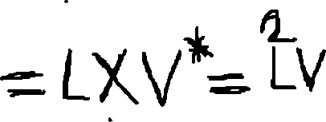
Language Level

Slide 67
Counting rules for C language
1.Comments are not considered.
2. The identifier and function declarations are not considered.
3. All the variables and constants are considered operands.
4. Global variables used in different modules of the same program are counted as multiple occurrences of the same variable.

Slide 68
5.Local variables with the same name in different functions are counted as unique operands.
6. Functions calls are considered as operators.
7. All looping statements e.g., do {…} while ( ), while ( ) {…}, for ( ) {…}, all control statements e.g., if ( ) {…}, if ( ) {…} else {…}, etc. are considered as operators.
8. In control construct switch ( ) {case:…}, switch as well as all the case statements are considered as operators.

Slide 69
The reserve words like return, default, continue, break, sizeof, etc., are considered as operators.
10. All the brackets, commas, and terminators are considered as operators.
11.GOTO is counted as an operator and the label is counted as an operand.
12. The unary and binary occurrence of “+” and “-” are dealt separately. Similarly “*” (multiplication operator) are dealt with separately.

Slide 70
13.In the array variables such as “array-name [index]” “arrayname” and “index” are considered as operands and [ ] is considered as operator.
14. In the structure variables such as “struct-name, member-name” or “struct-name -> member-name”, struct-name, member-name are taken as operands and ‘.’, ‘->’ are taken as operators. Some names of member elements in different structure variables are counted as unique operands.
15. All the hash directive are ignored.

Slide 71






Problem-1
Consider the sorting program as mentioned below. List out the operators and operands and also calculate the values of software science measures like

Slide 72
operators | occurrences | operands | occurrences
int | 4 | sort | 1
() | 5 | x | 7
, | 4 | n | 3
[] | 7 | i | 8
if | 2 | j | 7
< | 2 | save | 3
; | 11 | im1 | 3
for | 2 | 2 | 2
= | 6 | 1 | 3
– | 1 | 0 | 1
<= | 2 | – | –
++ | 2 | – | –
return | 2 | – | –
{} | 3 | – | –
n1=14 | N1=53 | n2=10 | N2=38

Slide 73

List of Operands & Operators
Operators | Occurrence | Operands | Occurrence
Int | 4 | SORT | 1
() | 5 | x | 7
, | 4 | n | 3
[] | 7 | i | 8
If | 2 | j | 7
< | 2 | save | 3
; | 11 | im1 | 3
for | 2 | 2 | 2
= | 6 | 1 | 3
- | 1 | 0 | 1
<= | 2 | - | -
++ | 2 | - | -
return | 2 | - | -
{} | 3 | - | -

Slide 74

Program Length: N=N1+N2=53+38=91
Vocabulary of the program: η1+ η2=14+10=24
Volume: V=N X log₂ η2=91x log₂ 24=417 bits
The estimated program length N
η1 log₂ η1 + η2 log₂ η2
14 log₂ 14 +10log₂ 10=86.45
Potential Volume=V*=(2+η2*) log2 (2+η2*)
unique input and output parameters are represented by η2*
η2*=3 so V*=(2+3) log2 (2+3)=11.6

Slide 75
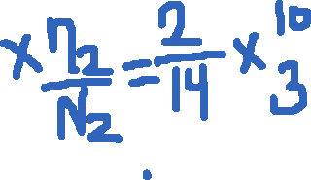



Program Level
L = V* / V=11.6/417=0.027
Program Difficulty
D = 1 / L =1/0.027=37.03
Estimated program level L

Slide 76


Language level by Halstead
Language | Language Level | Variance
PL/1 | 1.53 | 0.92
ALGOL | 1.21 | 0.74
FORTRAN | 1.14 | 0.81
CDC Assembly | 0.88 | 0.42
PASCAL | 2.54 | ----
APL | 2.42 | ----
C | 0.857 | 0.445

Slide 77
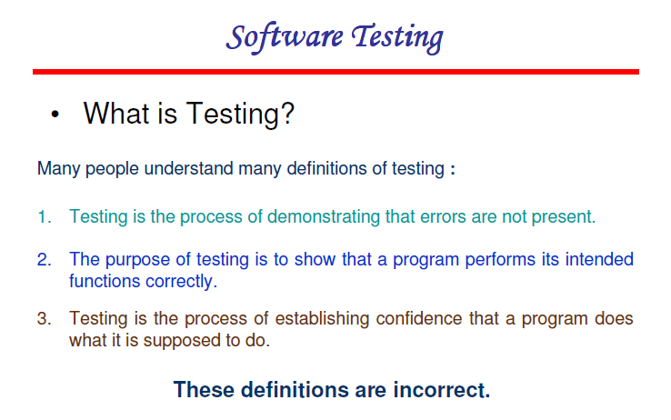

Slide 78
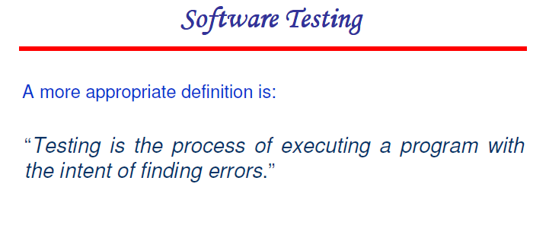

Slide 79
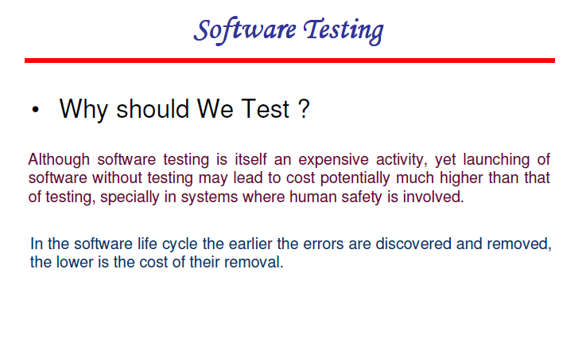

Slide 80
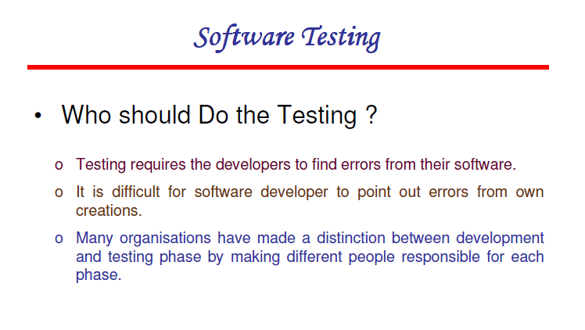

Slide 81
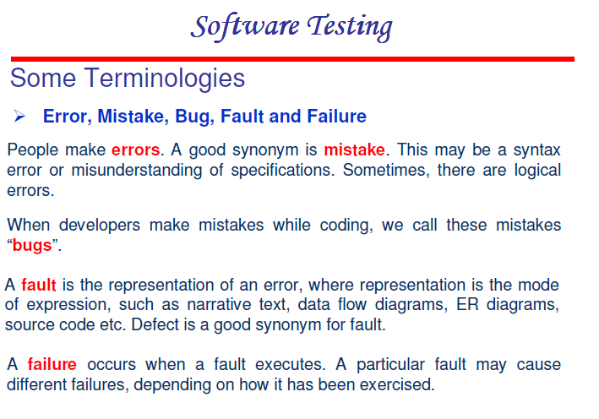

Slide 82
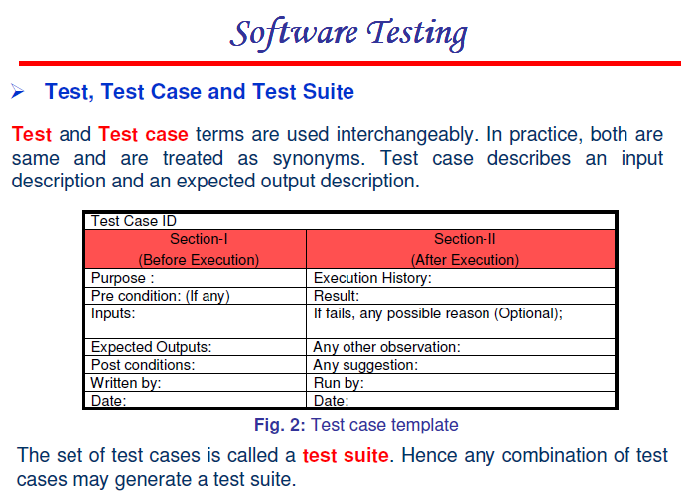

Slide 83
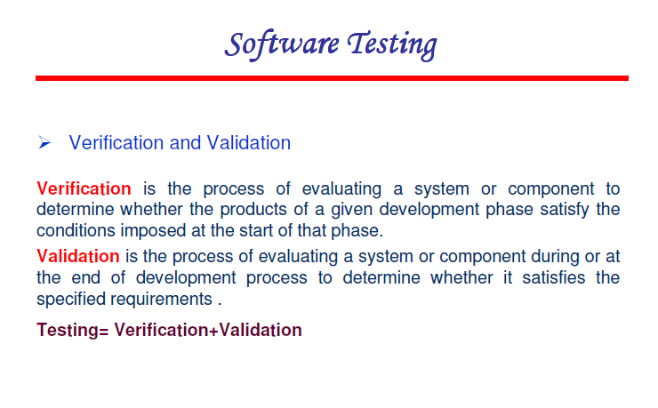

Slide 84
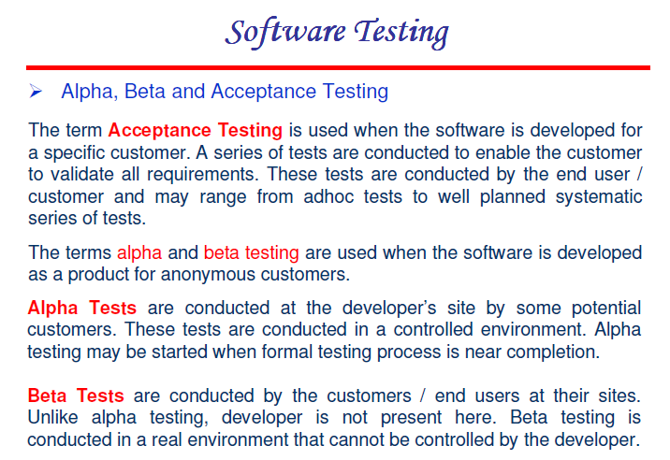

Slide 85
What are different types of software testing?
1. Manual Testing: Manual testing includes testing software manually, i.e., without using any automated tool or any script. In this type, the tester takes over the role of an end-user and tests the software to identify any unexpected behavior or bug. There are different stages for manual testing such as unit testing, integration testing, system testing, and user acceptance testing.
2.Automation Testing: Automation testing, which is also known as Test Automation, is when the tester writes scripts and uses another software to test the product. This process involves the automation of a manual process. Automation Testing is used to re-run the test scenarios that were performed manually, quickly, and repeatedly.

Slide 86
What are different levels of software testing?
1. Unit Testing: A level of the software testing process where individual units/components of a software/system are tested. The purpose is to validate that each unit of the software performs as designed.
2. Integration Testing: A level of the software testing process where individual units are combined and tested as a group. The purpose of this level of testing is to expose faults in the interaction between integrated units.
3. System Testing: A level of the software testing process where a complete, integrated system/software is tested. The purpose of this test is to evaluate the system’s compliance with the specified requirements.
4. Acceptance Testing: A level of the software testing process where a system is tested for acceptability. The purpose of this test is to evaluate the system’s compliance with the business requirements and assess whether it is acceptable for delivery.

Slide 87
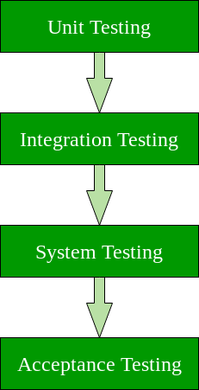

Slide 88
Software techniques can be majorly classified into two categories
1. Black Box Testing: The technique of testing in which the tester doesn’t have access to the source code of the software and is conducted at the software interface without concern with the internal logical structure of the software is known as black-box testing.
2. White-Box Testing: The technique of testing in which the tester is aware of the internal workings of the product, has access to its source code, and is conducted by making sure that all internal operations are performed according to the specifications is known as white box testing.

Slide 89
Black Box Testing | White Box Testing
Internal workings of an application are not required. | Knowledge of the internal workings is a must.
Also known as closed box/data-driven testing. | Also known as clear box/structural testing.
End users, testers, and developers. | Normally done by testers and developers.
This can only be done by a trial and error method. | Data domains and internal boundaries can be better tested.

Slide 90
Types of Black Box Testing
There are many types of Black Box Testing but the following are the prominent ones –
Functional testing – This black box testing type is related to the functional requirements of a system; it is done by software testers.
Non-functional testing – This type of black box testing is not related to testing of specific functionality, but non-functional requirements such as performance, scalability, usability.
Regression testing – Regression Testing is done after code fixes, upgrades or any other system maintenance to check the new code has not affected the existing code.

Slide 91
Techniques Used in Black Box Testing
Decision Table Technique | Decision Table Technique is a systematic approach where various input combinations and their respective system behavior are captured in a tabular form. It is appropriate for the functions that have a logical relationship between two and more than two inputs.
Boundary Value Technique | Boundary Value Technique is used to test boundary values, boundary values are those that contain the upper and lower limit of a variable. It tests, while entering boundary value whether the software is producing correct output or not.
State Transition Technique | State Transition Technique is used to capture the behavior of the software application when different input values are given to the same function. This applies to those types of applications that provide the specific number of attempts to access the application.
All-pair Testing Technique | All-pair testing Technique is used to test all the possible discrete combinations of values. This combinational method is used for testing the application that uses checkbox input, radio button input, list box, text box, etc.

Slide 92
Techniques Used in Black Box Testing
Cause-Effect Technique | Cause-Effect Technique underlines the relationship between a given result and all the factors affecting the result.It is based on a collection of requirements.
Equivalence Partitioning Technique | Equivalence partitioning is a technique of software testing in which input data divided into partitions of valid and invalid values, and it is mandatory that all partitions must exhibit the same behavior.
Error Guessing Technique | Error guessing is a technique in which there is no specific method for identifying the error. It is based on the experience of the test analyst, where the tester uses the experience to guess the problematic areas of the software.
Use Case Technique | Use case Technique used to identify the test cases from the beginning to the end of the system as per the usage of the system. By using this technique, the test team creates a test scenario that can exercise the entire software based on the functionality of each function from start to end.

Slide 93
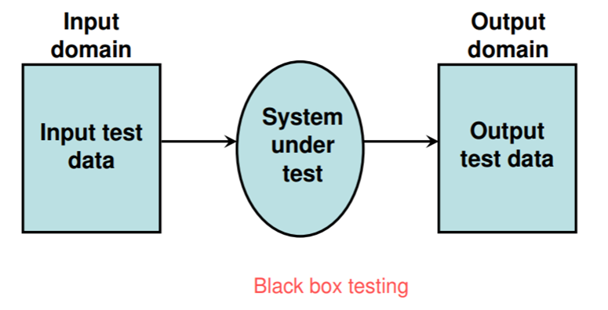
Functional testing
Functional Testing- testing based on functionality of the program rather than internal structure of the code (Black box testing)

Slide 94
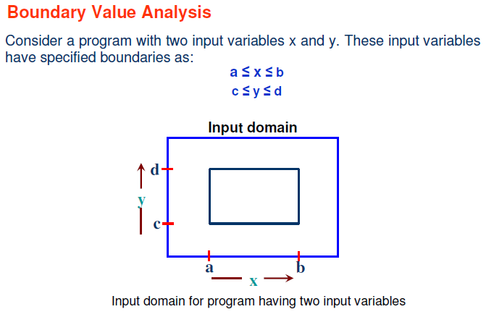

Slide 95
Boundary value analysis is the best known functional testing technique.
The objective of functional testing is to use knowledge of the functional nature of a program to identify test cases.
Historically, functional testing has focused on the input domain, but it is a good supplement to consider test cases based on the range as well.
Boundary value analysis focuses on the boundary of the input space to identify test cases.

Slide 96
Value Selection in Boundary Value Analysis
The basic idea in boundary value analysis is to select input variable values at their:
Minimum
Just above the minimum
A nominal value
Just below the maximum
Maximum

Slide 97
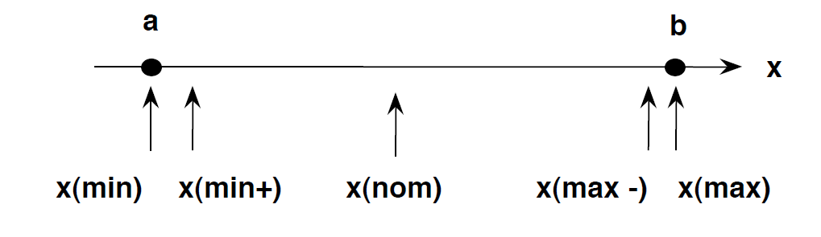

Slide 98
Boundary Value Analysis for Program
.
.
.. . ..
.
.

Slide 99
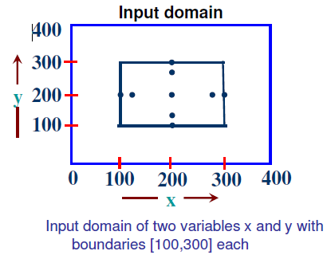
The Boundary Value Analysis
The boundary value analysis test cases for our program with two inputs
Variables (x and y) that may have any value from 100 to 300 are:
(200,100),(200,101), (200,200), (200,299), (200,300), (100,200), (101,200), (299,200) and
(300,200).
This input domain is shown in Fig.. Each dot represent a test case
and inner rectangle is the domain of legitimate inputs. Thus, for a program of n
variables, boundary value analysis yield 4n + 1 test cases.

Slide 100
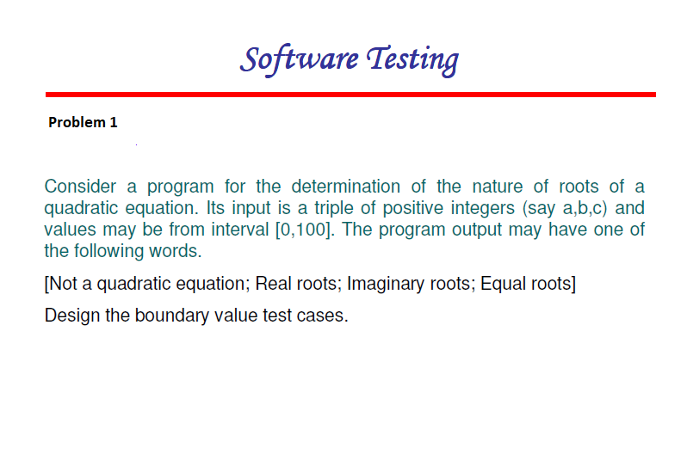

Slide 101
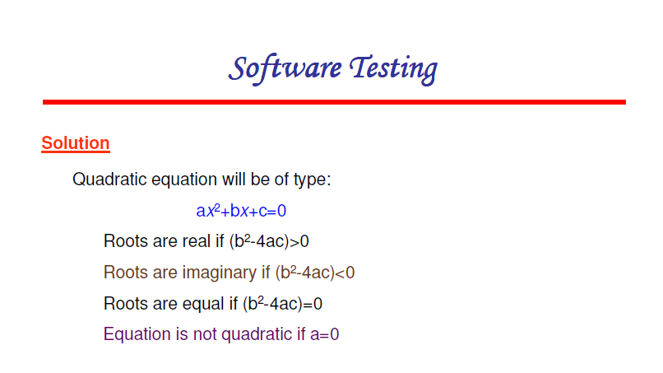

Slide 102
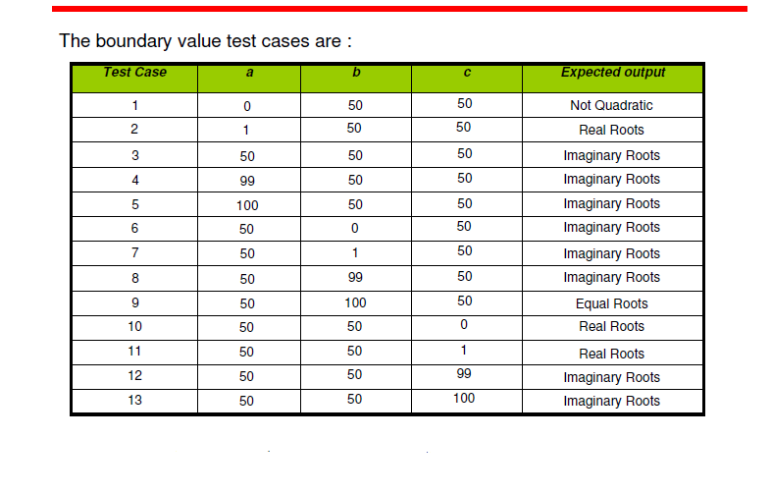
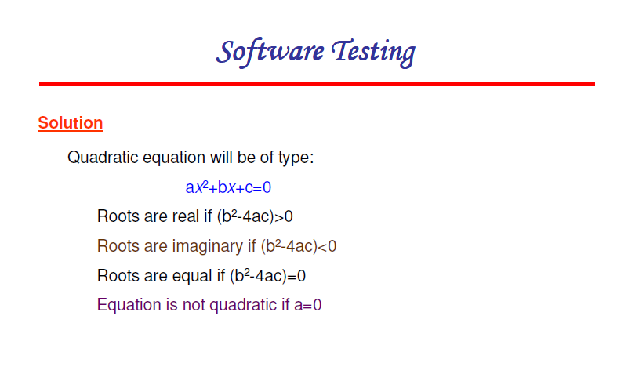

Slide 103
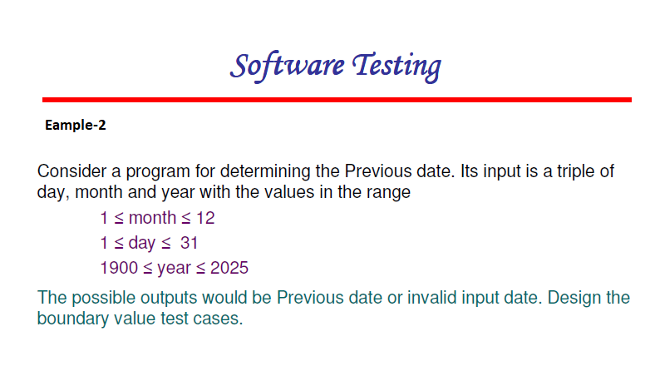

Slide 104
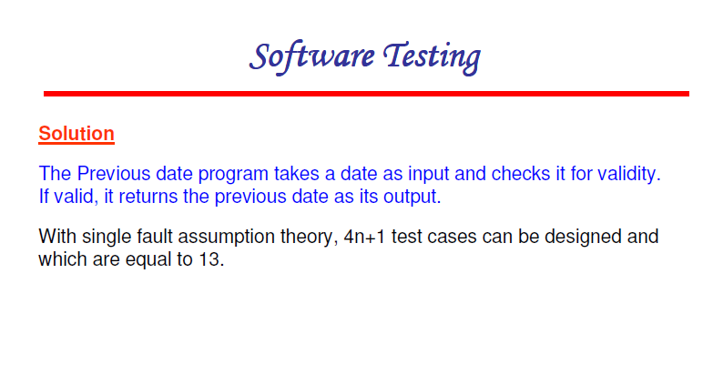

Slide 105
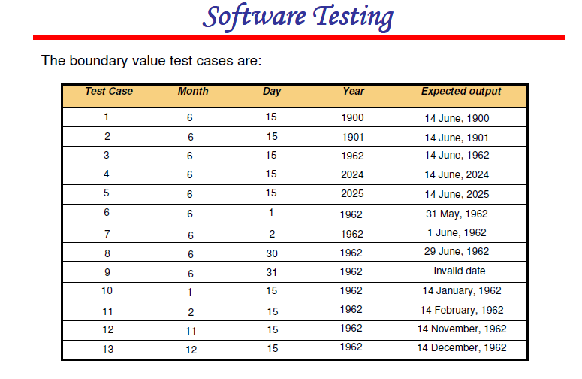

Slide 106
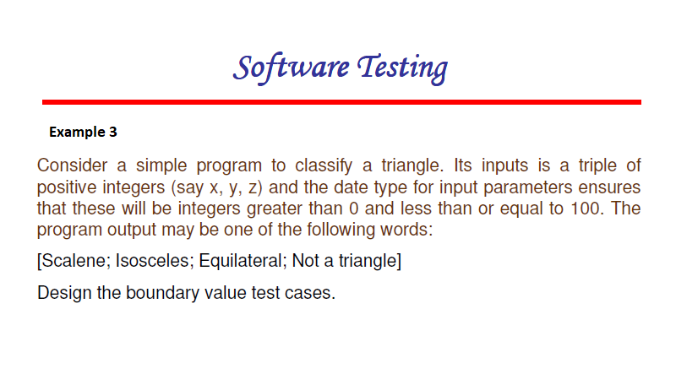

Slide 107
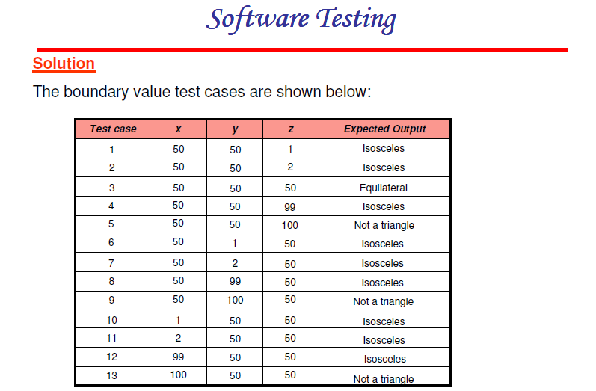

Slide 108

Robustness Testing

Slide 109

Robustness Testing

Slide 110


Slide 111


Slide 112


Slide 113


Slide 115


Slide 116


Slide 117


Slide 118


Slide 119



Slide 120


Slide 121


Slide 122


Slide 123



Slide 124


Slide 125


Slide 126

Y

Slide 127


Slide 128


Slide 129


Slide 130

Solution

Slide 131


Slide 132


Slide 133

Worst Case Testing

Slide 134

Worst Case Analysis

Slide 135


Slide 136


Slide 137


Slide 138


Slide 139


Slide 140


Slide 141


Slide 142


Slide 143


Slide 144


Slide 145


Slide 146
Decision Table Testing
Decision table technique is one of the widely used case design techniques for black box testing. This is a systematic approach where various input combinations and their respective system behavior are captured in a tabular form.
That's why it is also known as a cause-effect table. This technique is used to pick the test cases in a systematic manner; it saves the testing time and gives good coverage to the testing area of the software application.
Decision table technique is appropriate for the functions that have a logical relationship between two and more than two inputs.
This technique is related to the correct combination of inputs and determines the result of various combinations of input. To design the test cases by decision table technique, we need to consider conditions as input and actions as output.

Slide 147

Parts of Decision Tables
Condition Stubs : The conditions are listed in this first upper left part of the decision table that is used to determine a particular action or set of actions.
Action Stubs : All the possible actions are given in the first lower left portion (i.e, below condition stub) of the decision table.
Condition Entries : In the condition entry, the values are inputted in the upper right portion of the decision table. In the condition entries part of the table, there are multiple rows and columns which are known as Rule.
Action Entries : In the action entry, every entry has some associated action or set of actions in the lower right portion of the decision table and these values are called outputs.

Slide 148
Types of Decision Tables :
The decision tables are categorized into two types and these are given below:
Limited Entry : In the limited entry decision tables, the condition entries are restricted to binary values.
Extended Entry : In the extended entry decision table, the condition entries have more than two values. The decision tables use multiple conditions where a condition may have many possibilities instead of only ‘true’ and ‘false’ are known as extended entry decision tables.

Slide 149
Example
Most of us use an email account, and when you want to use an email account, for this you need to enter the email and its associated password.
If both email and password are correctly matched, the user will be directed to the email account's homepage; otherwise, it will come back to the login page with an error message specified with "Incorrect Email" or "Incorrect Password."

Slide 150

Example

Slide 151
Number of possible conditions = 2^ Number of Values of the second condition Number of possible conditions =2^2 = 4

Slide 152



Slide 153


Slide 154


Slide 155


Slide 156
Structural Testing
Structural testing, also known as glass box testing or white box testing is an approach where the tests are derived from the knowledge of the software's structure or internal implementation.
The other names of structural testing includes clear box testing, open box testing, logic driven testing or path driven testing.
Structural Testing Techniques:
Statement Coverage - This technique is aimed at exercising all programming statements with minimal tests.
Branch Coverage - This technique is running a series of tests to ensure that all branches are tested at least once.
Path Coverage - This technique corresponds to testing all possible paths which means that each statement and branch are covered.

Slide 157

Types of Structural Testing: There are 4 types of Structural Testing:

Slide 158
Control Flow Testing: Control flow testing is a type of structural testing that uses the programs’s control flow as a model. The entire code, design and structure of the software have to be known for this type of testing.
Data Flow Testing: It uses the control flow graph to explore the unreasonable things that can happen to data. The detection of data flow anomalies are based on the associations between values and variables.
Slice Based Testing: It was originally proposed by Weiser and Gallagher for the software maintenance. It is useful for software debugging, software maintenance, program understanding and quantification of functional cohesion. It divides the program into different slices and tests that slice which can majorly affect the entire software.
Mutation Testing: Mutation Testing is a type of Software Testing that is performed to design new software tests and also evaluate the quality of already existing software tests. Mutation testing is related to modification a program in small ways. It focuses to help the tester develop effective tests or locate weaknesses in the test data used for the program.

Slide 159
Advantages of Structural Testing:
It provides thorough testing of the software.
It helps in finding out defects at an early stage.
It helps in elimination of dead code.
It is not time consuming as it is mostly automated.
Disadvantages of Structural Testing:
It requires knowledge of the code to perform test.
It requires training in the tool used for testing.
Sometimes it is expensive.
Structural Testing Tools:
JBehave
Cucumber
Junit
Cfix

Slide 160


Slide 161


Slide 162


Slide 163


Slide 164


Slide 165


Slide 166


Slide 167


Slide 168


Slide 169
Cyclomatic Complexity
Cyclomatic complexity of a code section is the quantitative measure of the number of linearly independent paths in it. It is a software metric used to indicate the complexity of a program. It is computed using the Control Flow Graph of the program.
V(G) = E – N + 2P
where, E = the number of edges in the control flow graph N = the number of nodes in the control flow graph P = the number of connected components

Slide 170


Slide 171


Slide 172


Slide 173


Slide 174


Slide 175


Slide 176


Slide 177


Slide 178


Slide 179
Graph Matrix
In graph matrix based testing, we convert Our flow graph into a square matrix with one row and one column for every node in the graph.
If the size of graph increases, it becomes difficult to do path tracing manually.

Slide 180

Process of constructing the Square Matrix leading to computation of Cyclomatic Complexity goes like this:
Step 1: Start from the following basic Flow Graph as an example of an input

Slide 181

Step 2: Construct its corresponding

Slide 182


Slide 183
It may be noted that if there are several links between two nodes then ” + ” sign denotes a parallel link.
This is, however, not very useful. Hence we assign a weight to each entry of the graph matrix.
We use ‘1’ to denote that the edge is present and ‘0’ to indicate its absence. Such a matrix is known as a connection matrix.

Slide 184

For above figure connection matrix can be shown as under.

Slide 185

Step 5: Compute it’s V(G) & draw the matrix again for the same

Slide 186
i.e., we sum each row of the above matrix. Then, we subtract “1” from each row. We, then, add this result or column of result and add “1” to it.
This gives us V(G).
For above matrix we get V(G) = 2.

Slide 187


Slide 188
Decision Table Testing
Decision table technique is one of the widely used case design techniques for black box testing. This is a systematic approach where various input combinations and their respective system behavior are captured in a tabular form.
That's why it is also known as a cause-effect table. This technique is used to pick the test cases in a systematic manner; it saves the testing time and gives good coverage to the testing area of the software application.
Decision table technique is appropriate for the functions that have a logical relationship between two and more than two inputs.
This technique is related to the correct combination of inputs and determines the result of various combinations of input. To design the test cases by decision table technique, we need to consider conditions as input and actions as output.

Slide 189
Parts of Decision Tables
Condition Stubs : The conditions are listed in this first upper left part of the decision table that is used to determine a particular action or set of actions.
Action Stubs : All the possible actions are given in the first lower left portion (i.e, below condition stub) of the decision table.
Condition Entries : In the condition entry, the values are inputted in the upper right portion of the decision table. In the condition entries part of the table, there are multiple rows and columns which are known as Rule.
Action Entries : In the action entry, every entry has some associated action or set of actions in the lower right portion of the decision table and these values are called outputs.

Slide 190
Types of Decision Tables :
The decision tables are categorized into two types and these are given below:
Limited Entry : In the limited entry decision tables, the condition entries are restricted to binary values.
Extended Entry : In the extended entry decision table, the condition entries have more than two values. The decision tables use multiple conditions where a condition may have many possibilities instead of only ‘true’ and ‘false’ are known as extended entry decision tables.

Slide 191
Example
Most of us use an email account, and when you want to use an email account, for this you need to enter the email and its associated password.
If both email and password are correctly matched, the user will be directed to the email account's homepage; otherwise, it will come back to the login page with an error message specified with "Incorrect Email" or "Incorrect Password."

Slide 192
Example

Slide 194


Slide 195


Slide 196


Slide 197


Slide 198


Slide 199


Slide 200


Slide 201


Slide 203


Slide 204


Slide 205


Slide 206


Slide 207


Slide 208


Slide 209


Slide 210


Slide 211


Slide 212

Software quality attributes

Slide 213


Slide 214


Slide 215


Slide 216


Slide 217


Slide 218


Slide 219


Slide 220


Slide 221


Slide 222


Slide 223


Slide 224


Slide 225


Slide 226


Slide 227



Slide 228


Slide 229


Slide 230


Slide 231


Slide 232


Slide 233


Slide 234


Slide 235


Slide 236


Slide 237



Slide 238


Slide 239


Slide 240


Slide 241


Slide 242


Slide 243


Slide 244
Software Reverse Engineering
It is a process of recovering the design, requirement specifications and functions of a product from an analysis of its code.
It builds a program database and generates information from this.
The purpose of reverse engineering is to facilitate the maintenance work by improving the understandability of a system and to produce the necessary documents for a legacy system.

Slide 245
Reverse Engineering Goals:
Cope with Complexity.
Recover lost information.
Detect side effects.
Synthesise higher abstraction.
Facilitate Reuse.

Slide 246
Steps of Software Reverse Engineering:
Collection Information: This step focuses on collecting all possible information (i.e., source design documents etc.) about the software.
Examining the information: The information collected in step-1 as studied so as to get familiar with the system.
Extracting the structure: This step concerns with identification of program structure in the form of structure chart where each node corresponds to some routine.
Recording the functionality: During this step processing details of each module of the structure, charts are recorded using structured language like decision table, etc.

Slide 247
Recording data flow: From the information exA tracted in step-3 and step-4, set of data flow diagrams are derived to show the flow of data among the processes.
Recording control flow: High level control structure of the software is recorded.
Review extracted design: Design document extracted is reviewed several times to ensure consistency and correctness. It also ensures that the design represents the program.
Generate documentation: Finally, in this step, the complete documentation including SRS, design document, history, overview, etc. are recorded for future use.

Slide 248
Reverse Engineering Tools:
Reverse engineering if done manually would consume lot of time and human labour and hence must be supported by automated tools. Some of tools are given below:
CIAO and CIA: A graphical navigator for software and web repositories along with a collection of Reverse Engineering tools.
Rigi: A visual software understanding tool.
Bunch: A software clustering/modularization tool.
GEN++: An application generator to support development of analysis tools for the C++ language.
PBS: Software Bookshelf tools for extracting and visualizing the architecture of programs.

Slide 249
Software Re-engineering
It is a process of software development which is done to improve the maintainability of a software system. Re-engineering is the examination and alteration of a system to reconstitute it in a new form. This process encompasses a combination of sub-processes like reverse engineering, forward engineering, reconstructing etc.
Objectives of Re-engineering:
To describe a cost-effective option for system evolution.
To describe the activities involved in the software maintenance process.
To distinguish between software and data re-engineering and to explain the problems of data re-engineering.

Slide 250
Steps involved in Re-engineering:
Inventory Analysis
Document Reconstruction
Reverse Engineering
Code Reconstruction
Data Reconstruction
Forward Engineering

